Slide 1



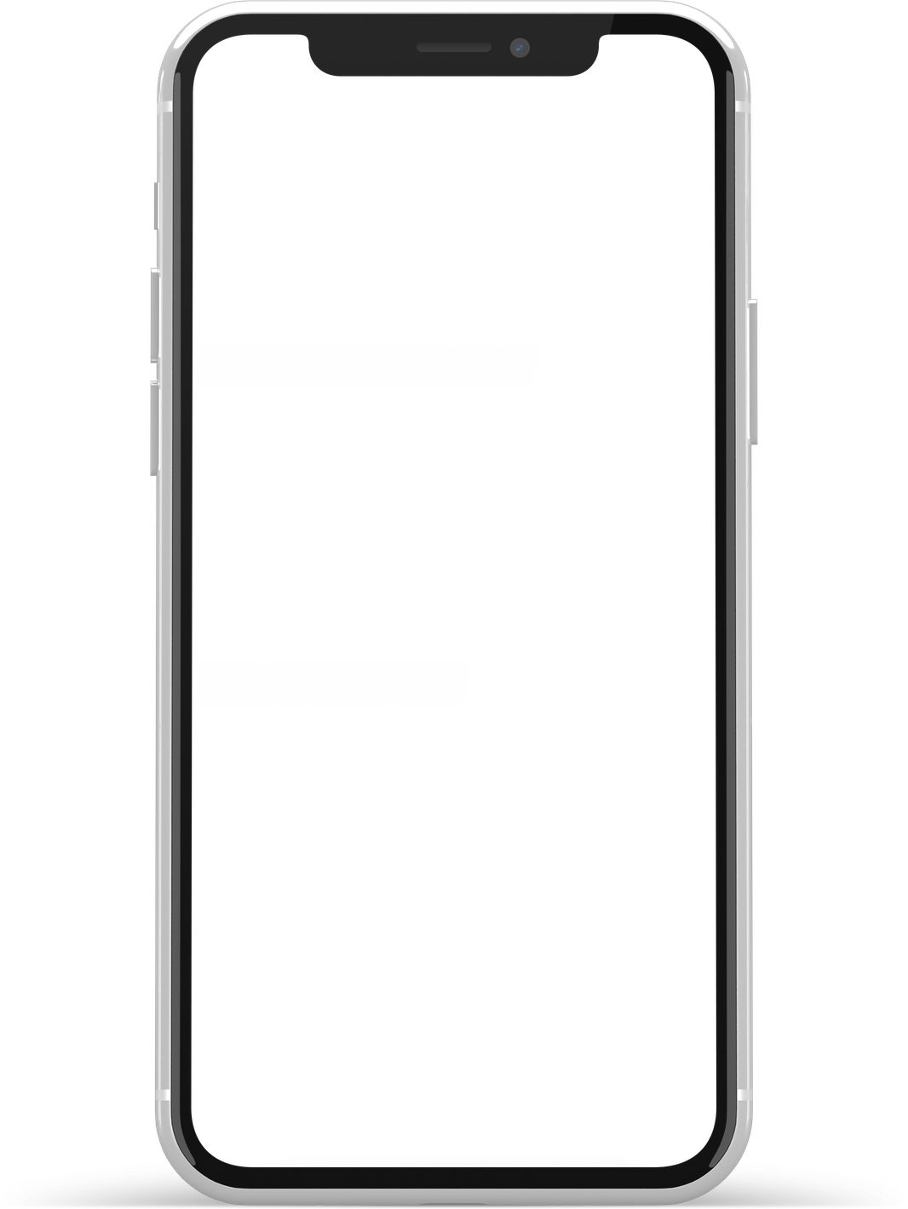




Why Businesses Need Custom On Demand App Development Services
Empowering businesses with tailored digital solutions that drive growth, efficiency, and long-term scalability in the on-demand economy.
Get Started

Slide 2

01
Introduction
Why Businesses Need Custom On Demand App Development Services
The rapid growth of the on-demand economy has transformed how customers interact with businesses. Today, users expect instant access, seamless booking, and real-time updates through mobile platforms. Custom On Demand App Development Services help businesses meet these expectations by creating tailored digital solutions that align perfectly with their operational goals. Unlike generic apps, custom solutions provide flexibility, scalability, and long-term value.
www.xinzex.com

Slide 3




02
Limitations of Ready-Made On Demand Solutions
Many businesses initially choose pre-built platforms, but these often come with restricted features and limited customization. An experienced On Demand App Development Company understands that every business has unique workflows, branding needs, and customer engagement strategies. Ready-made solutions may limit growth, restrict integrations, and create dependency on third-party systems, making it harder to scale efficiently in competitive markets.
Pay

Slide 4


03
Advantages of Partnering with an On Demand App Development Company in USA
Working with a professional On Demand App Development Company in USA ensures high-quality standards, advanced security protocols, and scalable architecture. Businesses benefit from industry expertise, modern technology stacks, and compliance with U.S. regulations. Custom development enables seamless integration of payment gateways, analytics tools, and CRM systems, giving companies full control over their digital ecosystem.
Major
Advantages

Slide 5

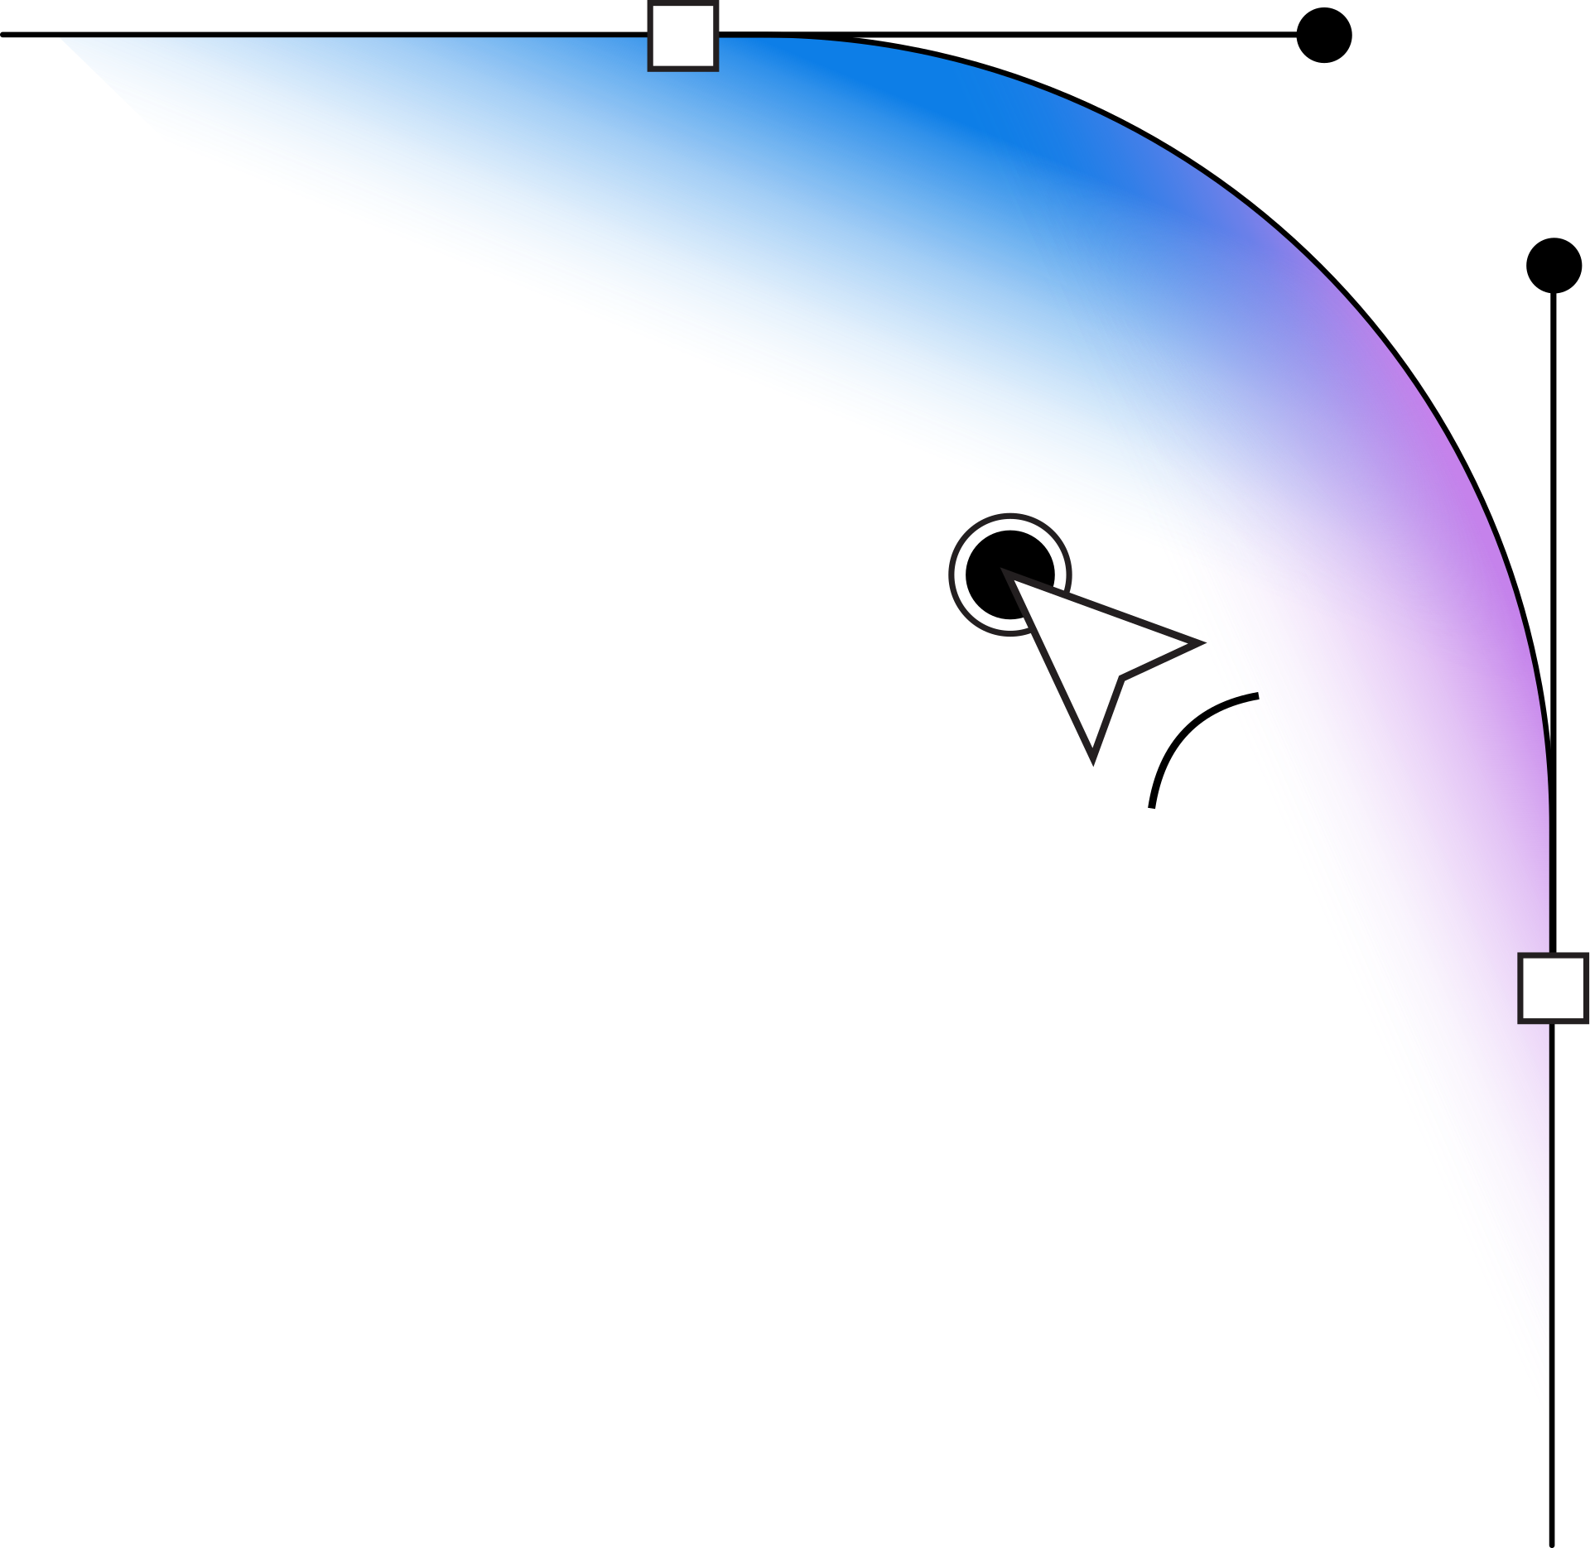
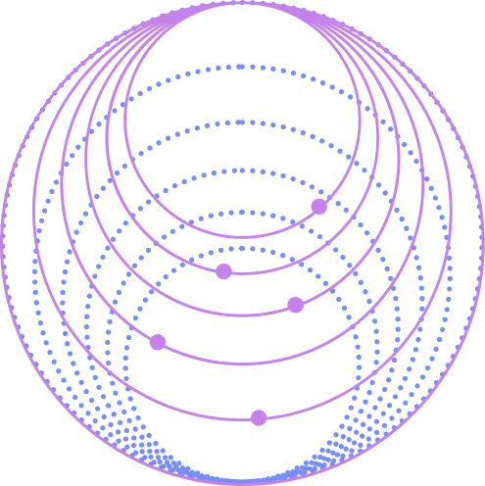
04
Industry-Specific On Demand App Development Services in USA
From food delivery and taxi booking to healthcare and home services, On Demand App Development Services in USA are tailored to meet industry-specific demands. Custom features such as scheduling systems, location tracking, service management dashboards, and customer feedback modules ensure that businesses operate smoothly while delivering exceptional user experiences.

Slide 6




05
contact us
Thank You!
www.xinzex.com
+1 8889 10 10 10
support@xinzex.com
651 N Broad st, Suite 206
Middletown, DE 19709

